Slide 1
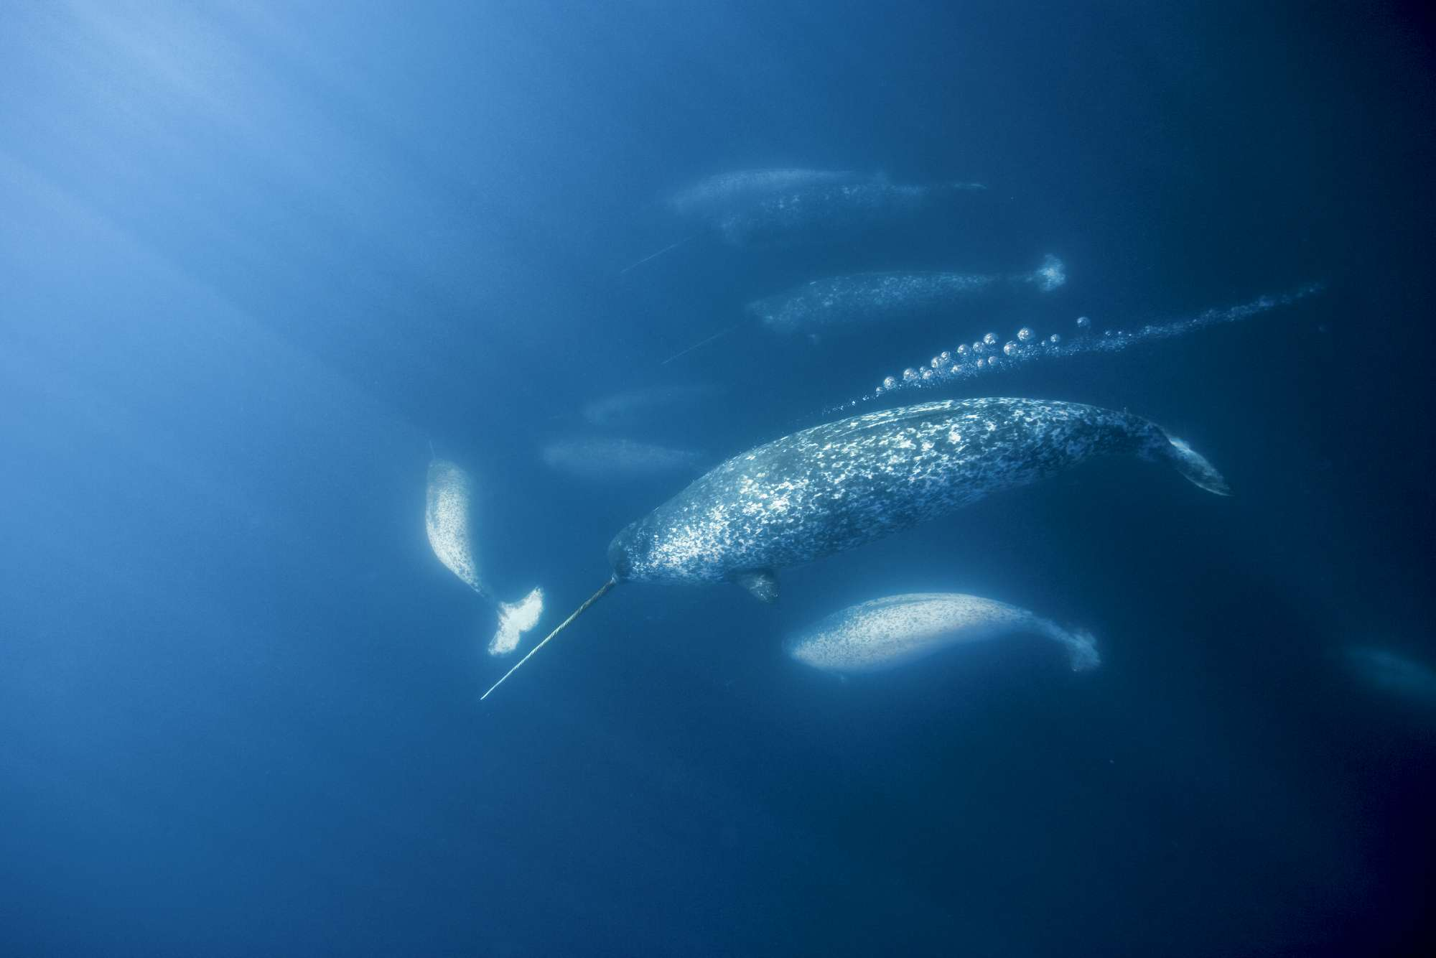
HMM FOR ANIMAL MOVEMENT TUTORIAL
Marie Auger-Méthé and Fanny Dupont

Slide 2
HMM OUTLINE
Ecological motivation
Statistical framework
Narwhal case study
HMMs
CRWs
Notes:
In this presentation, I will briefly discuss the Ecological motivations for HMMs, their statistical framework, in which mixture models and Markov chains combine to make HMMs.
I conclude the talk by presenting the narwhal case study that this workshop is based on.
This workshop

Slide 3
Motivation

Slide 4
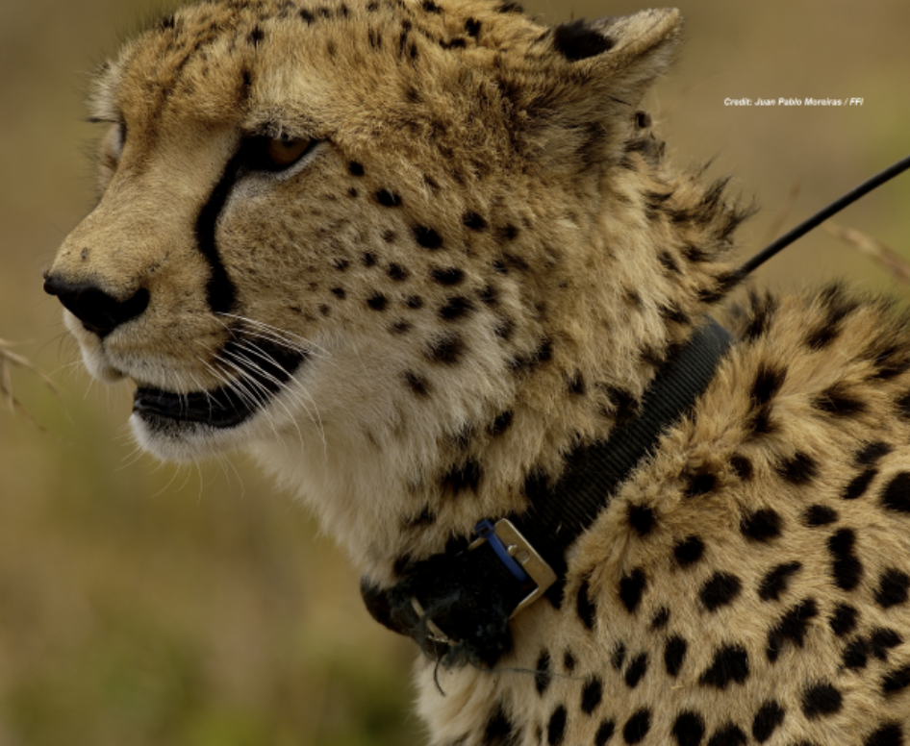
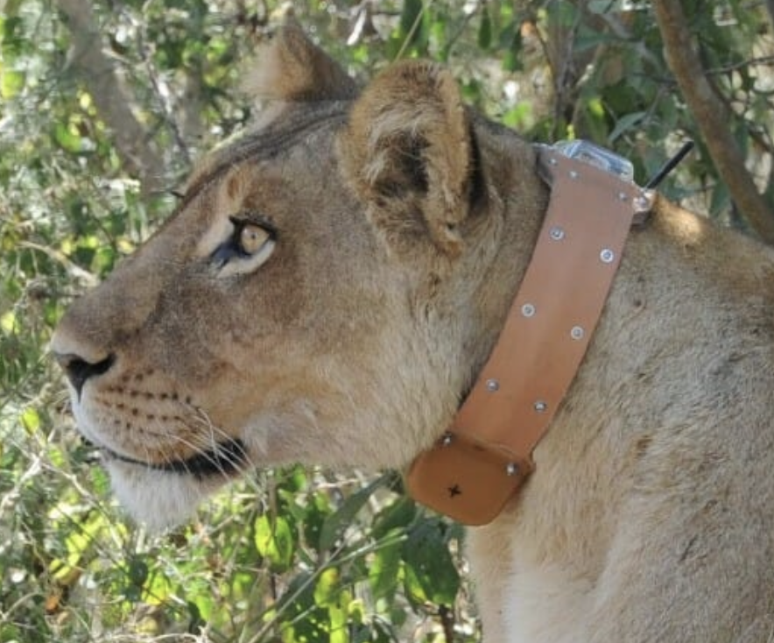
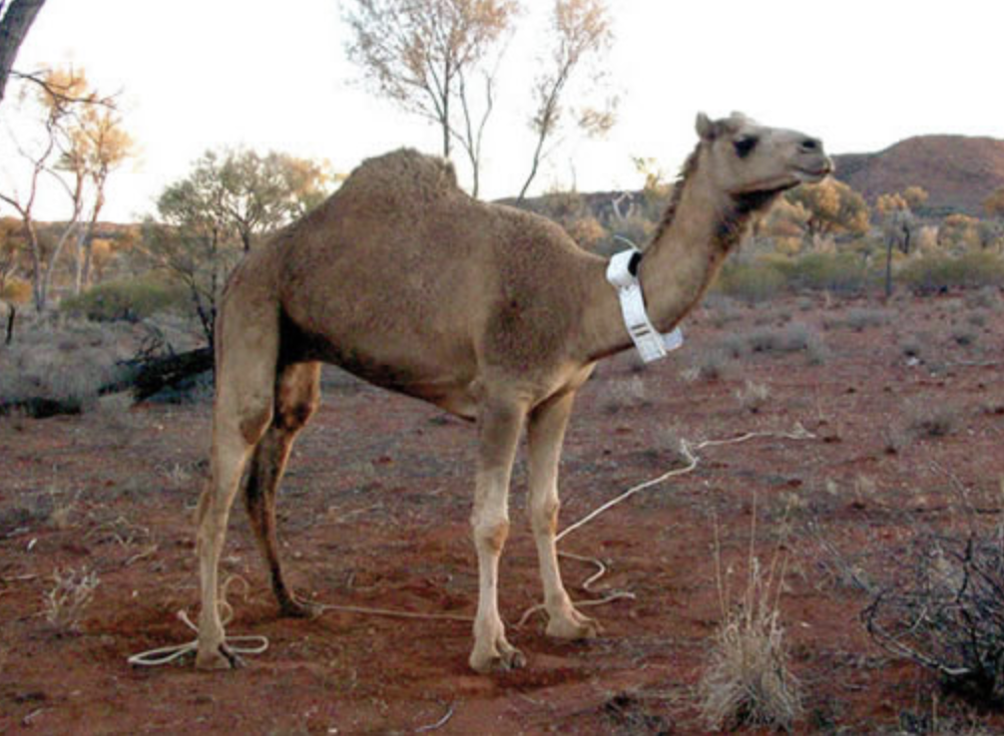
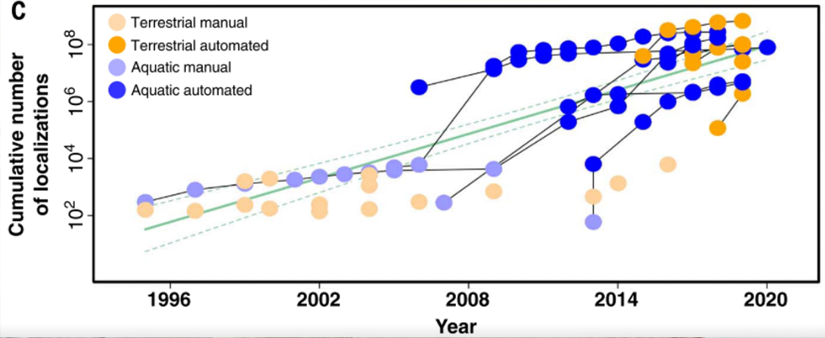
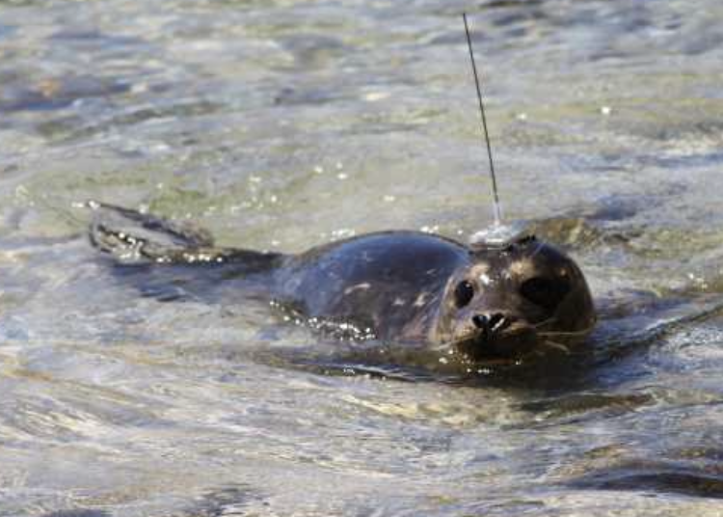
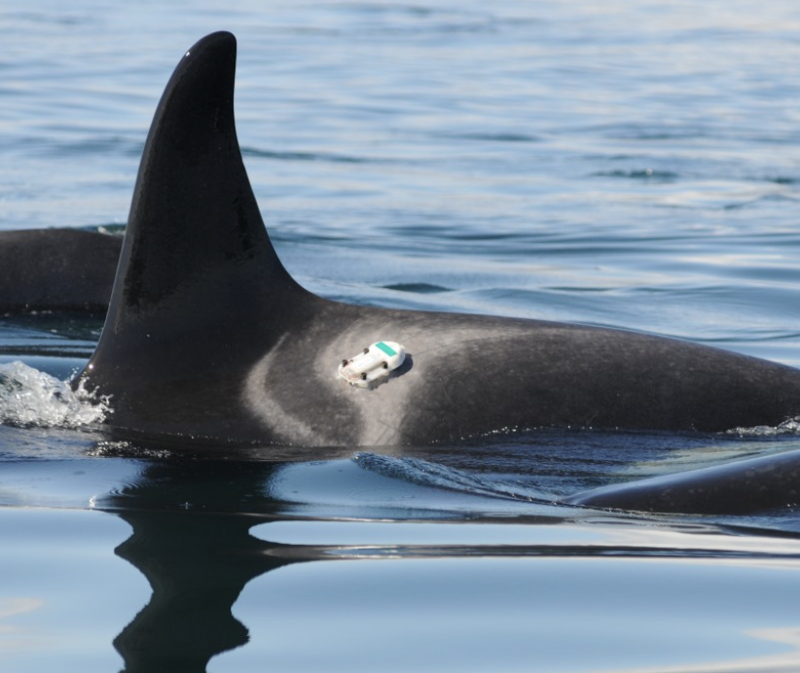
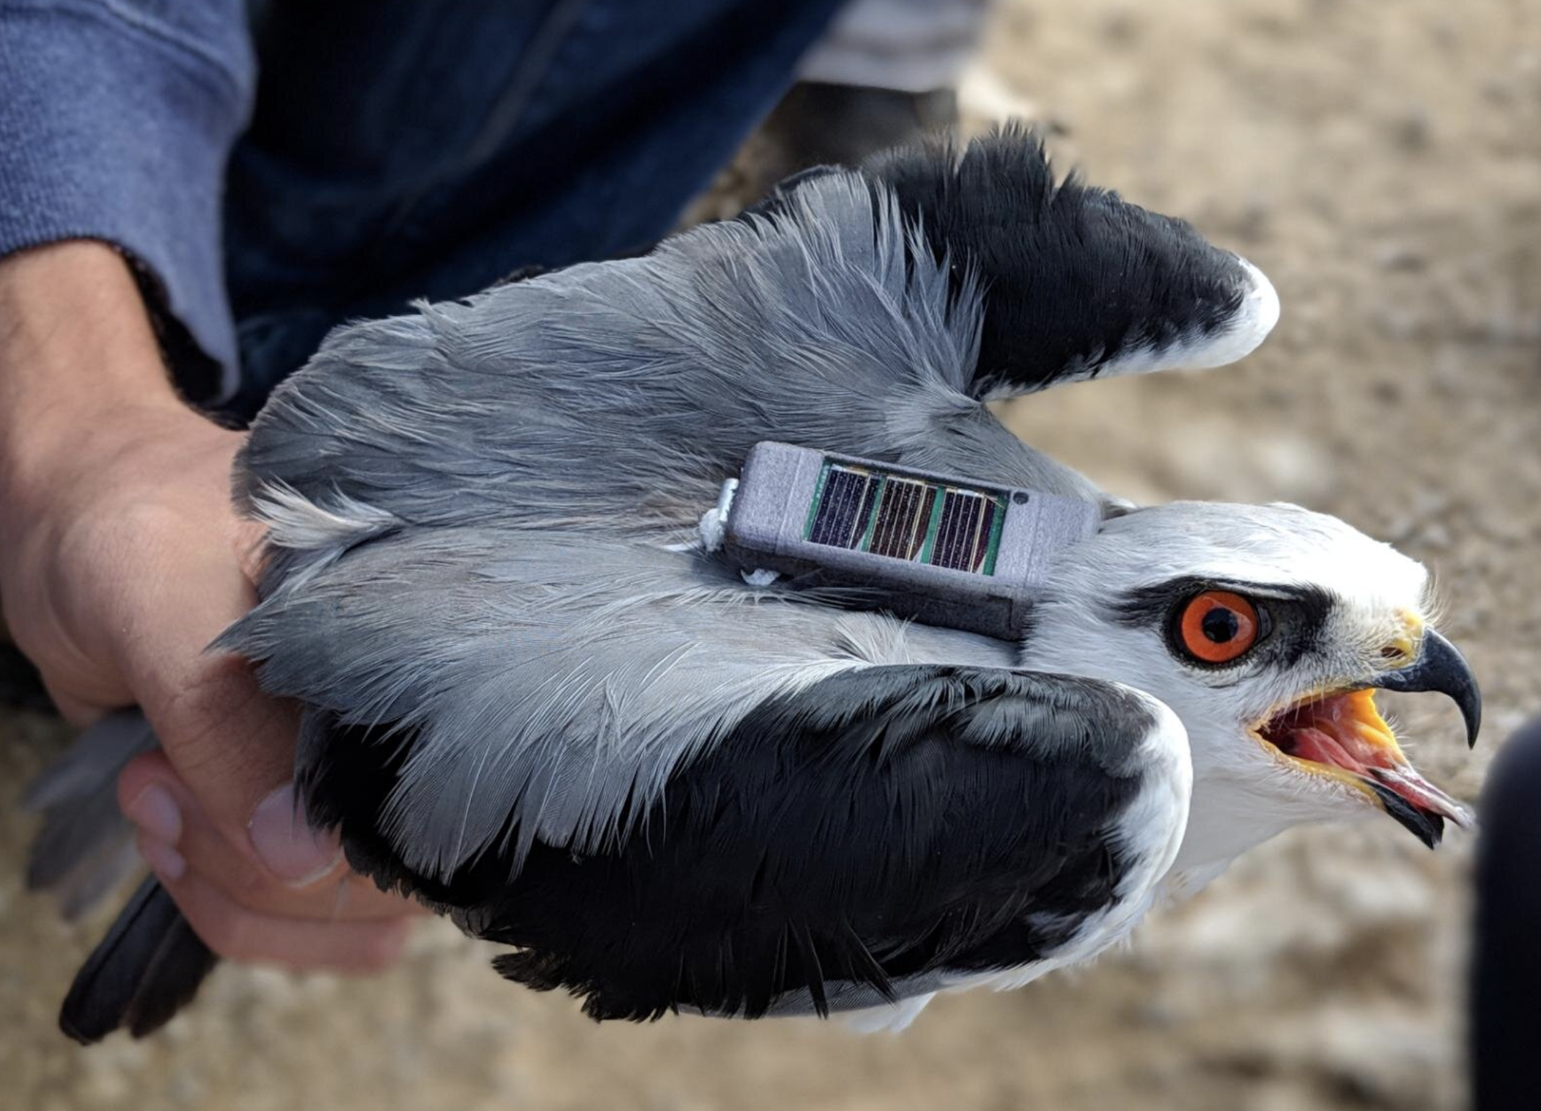
Nathan, R., Monk, C. T., Arlinghaus, R., Adam, T., Alós, J., Assaf, M., ... & Jarić, I. (2022). Big-data approaches lead to an increased understanding of the ecology of animal movement. Science, 375(6582), eabg1780.
Notes:
Animal movement data is very common. Over the past several decades, we've been collecting more and more remote biotelemetry from animals.
This includes movement data such as the animal’s geographic location, elevation, depth, accelerometer data, orientation relative to the poles,
As well as physiological data such as body temperature, and heart-rate. The overall amount of data collected in both terrestrial and marine systems has been growing exponentially

Slide 5
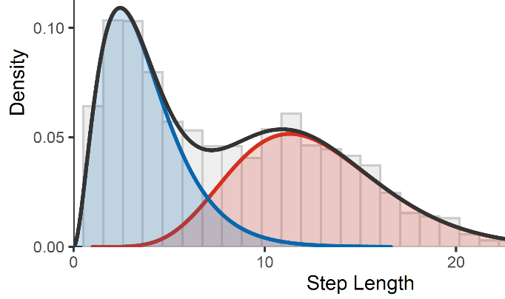
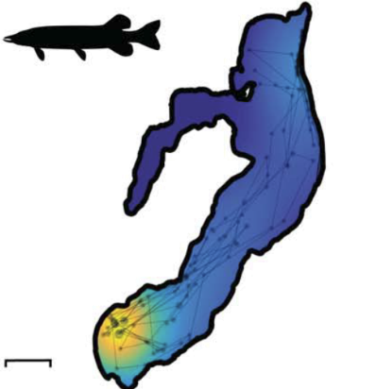
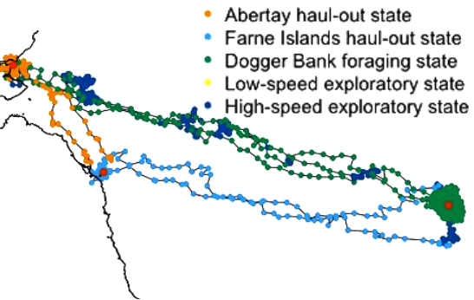
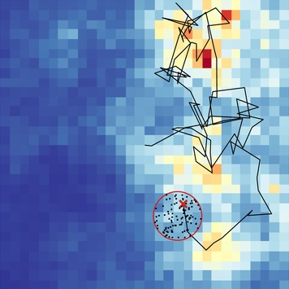
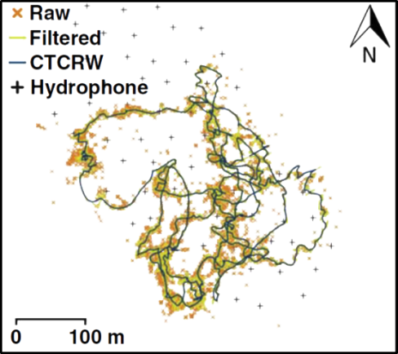
Movement modelling
i
Movement parameter estimation
Nathan et al, 2022
Home range estimation
Behaviour segmentation
Habitat & resource selection
Michelot et al. 2017
Path reconstruction
Michelot et al. 2017
Nathan et al, 2022
Notes:
there are many possible avenues to investigate this data.
1. For example, with respect to movement data, we may be interested in estimating an animal's home range; where they are geographically in space, and where their distribution is concentrated.
2. Second, we may be interested in habitat and resource selections, where we want to identify what kind of environmental conditions do animals select for, for example bathymetry, sea surface temperature, or chlorophyll concentrations.
3. Next, we may be interested in parameterizing the animals’ movement characteristics. For example, this case the graph shows the distribution of step length for two different behaviors.
4. 4th, we may be interested segmenting the telemetry data into discrete behavioral States and identifying when and where those occur or under which conditions
5. last, if the data has high error or if we have missing records, we may be interested in path reconstruction to determine the most likely paths of the animals and where they may have been over time
Hidden Markov models address two of these components: movement parameter estimation, and behavior segmentation
And in this this workshop, we will also learn some basic methods for path reconstruction.

Slide 6
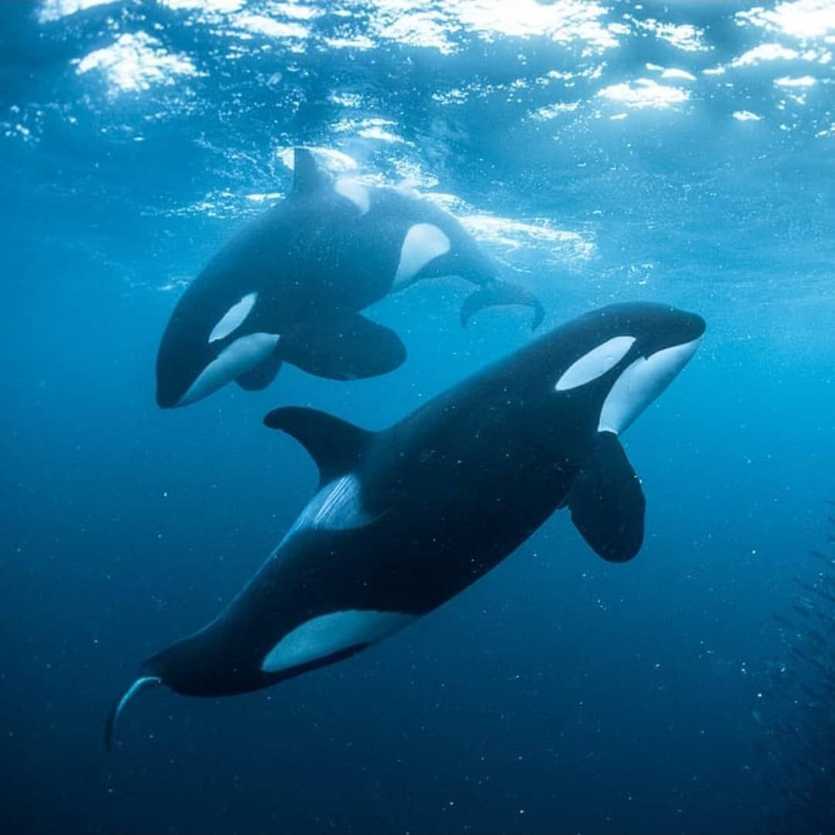
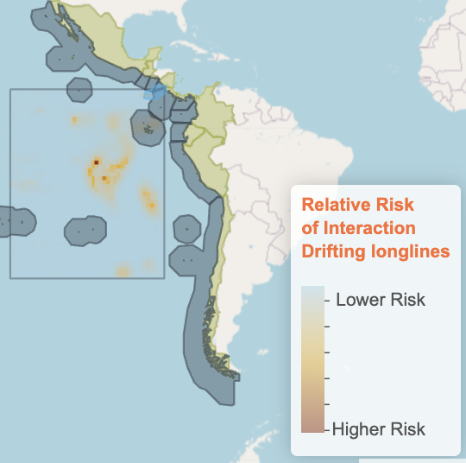
Why behaviour ?
Energy Expenditure
Conservation studies
McRae et al. 2024
Barbour et al. 2022
Notes:
Energy expenditure:
It is fundamentally important for many animal ecologists to quantify the costs of animal activities it is understood as an important factor in lifetime reproductive success + can be linked to estimate prey requirements. Animals spends diff amount of energy depending on what they are doing, and ecologists are usually interested in behavioural specific energy costs. For example, Tess Mc Rae investigated behavioural-specific energy expenditure of cetaceans in the wild (through respiration rate) => can be used to estimate the amounts of energy cetaceans require to support the different activities they engage in each day. We can also be interested in the cost of traveling for animals for migrate etc..
Conservation studies:
Understand why behaviours occur where they do to identify important habitats, associated w key behaviours and implement conservation and management policies such as marine protected areas. To inform place-based management decisions with inferences from movement HMMs, we must be able to identify both important habitat (e.g. stop-over sites) and the behaviour(s) associated with it (e.g. migration). This is key for identifying what parts of space have disproportionate functional value to an animal population and deserve further protection or management (Lennox et al., 2019).
Nicole Barbour et al created an interactive tool based on animal behaviour to predict the high-risk bycatch areas for turtles undertaking specific behaviors.

Slide 7
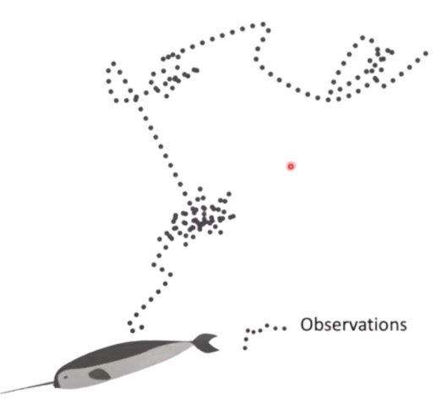
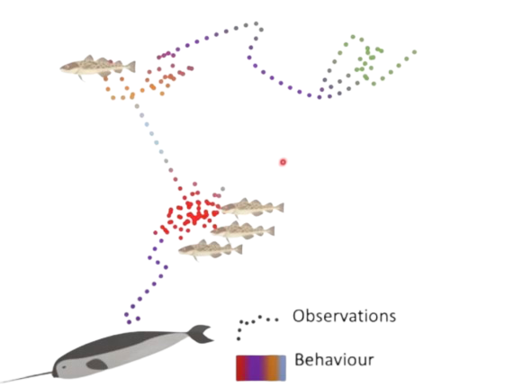
Hidden Markov models: motivations
Underlying biological process is hidden
Observation is conditional on latent process
Behaviour state vs location data
Notes:
So hidden Markov models have two components addressing two fundamental challenges when using telemetry data to identify behavioral states.
The first challenge is that the underlying biological process that researchers are interested in is not directly observed.
That is, the data stream we obtain is an indirect measure of that underlying behavioral process,
Such that observation data conditionally dependent on a latent state process.
For example, if me use catch data to estimate the stock size of a fish species, the true population is hidden. a second example, and the primary focus of this Workshop is using observed movement data to infer an unobserved (or latent) animal behaviour
The second challenge is that latent state process is also autocorrelated in time.
For example, the stock population size in one year is partly dependent on the population in the previous year,
and animal behavior at one time depends on what it was doing previously.
In effect our observation data is autocorrelated through a latent state process.

Slide 8
Hidden Markov Models

Slide 9
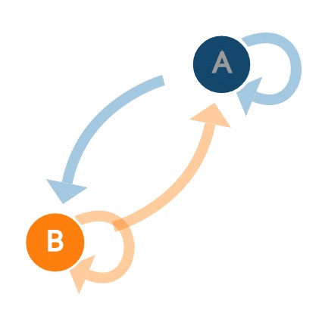
Hidden Markov models - Solution
Underlying biological process is hidden
Finite mixture model
Latent process is autocorrelated
Markov chain
Notes:
Hidden Markov models address these challenges by combining two different statistical tools.
For the observation process, we have finite mixture models.
in the graph on the right, the red line represents the overall observation data, and this data is emergent from several hidden processes represented by the blue curves.
To model the autocorrelation, HMMs describe the probability of the latent states using Markov chains, which say that the probability of being in a state at some time depends on what state you were in in the previous time.
In the Markov chain, there is a probability of staying within the same state, and a probability of transitioning to the another states.
Next, we’ll go into both of these components in more detail then discuss how they are combined into the Hidden Markov model.

Slide 10


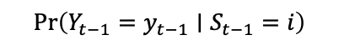
Hidden Markov models – Framework
S
𝚪
S
𝚪
S
t-1
t
t+1
$$Pr\left(Y_{t−1}=y_{t−1}∣S_{t−1}=i\right)$$
$$Pr\left(Y_{t}=yt∣S_{t}=i\right)$$
$$Pr\left(Y_{t+1}=y_{t+1}∣S_{t+1}=i\right)$$
Y
Y
Y
t-1
t
t+1
Notes:
Hidden Markov models address these challenges by combining two different statistical tools.
For the observation process, we have finite mixture models.
in the graph on the right, the red line represents the overall observation data, and this data is emergent from several hidden processes represented by the blue curves.
To model the autocorrelation, HMMs describe the probability of the latent states using Markov chains, which say that the probability of being in a state at some time depends on what state you were in in the previous time.
In the Markov chain, there is a probability of staying within the same state, and a probability of transitioning to the another states.
Next, we’ll go into both of these components in more detail then discuss how they are combined into the Hidden Markov model.

Slide 11
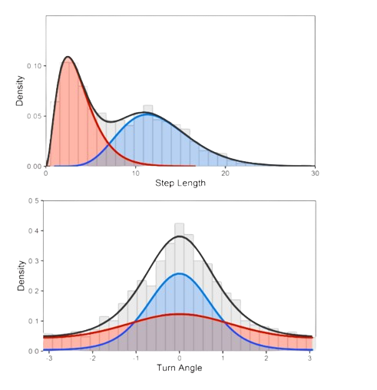
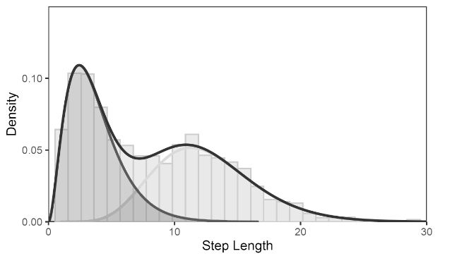
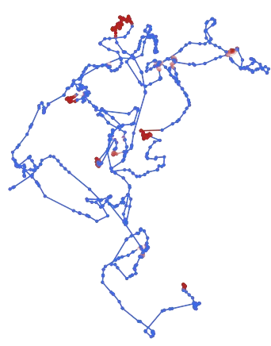
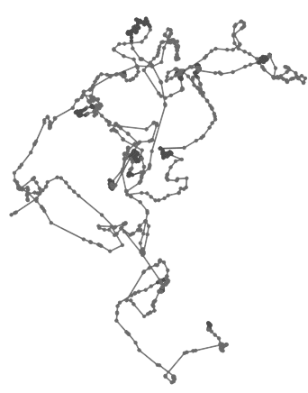
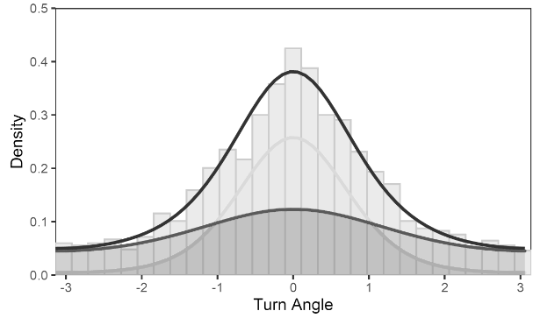
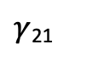
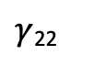
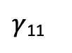
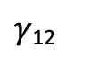
Hidden Markov models – 2 states
$γ$₁₂
$γ$₁₁
$γ$₂₂
$γ$₂₁
Notes:
Hidden Markov models address these challenges by combining two different statistical tools.
For the observation process, we have finite mixture models.
in the graph on the right, the red line represents the overall observation data, and this data is emergent from several hidden processes represented by the blue curves.
To model the autocorrelation, HMMs describe the probability of the latent states using Markov chains, which say that the probability of being in a state at some time depends on what state you were in in the previous time.
In the Markov chain, there is a probability of staying within the same state, and a probability of transitioning to the another states.
Next, we’ll go into both of these components in more detail then discuss how they are combined into the Hidden Markov model.

Slide 12
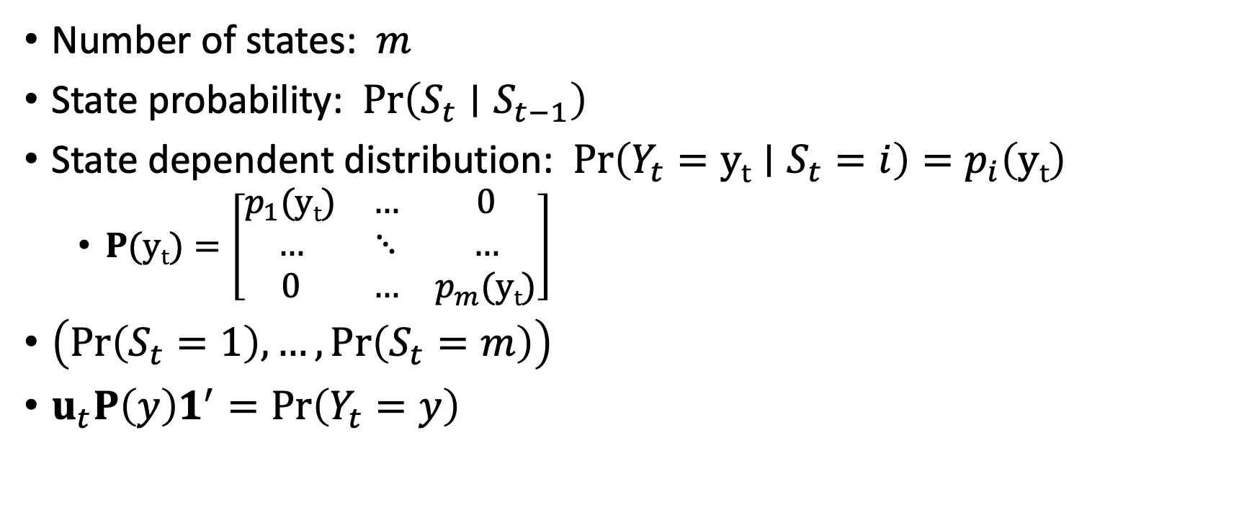
HMM: Key parameters
Number of states: $m$
State probability: $Pr\left(S_{t}∣S_{t−1}\right)$
State dependent distribution: $Pr\left(Y_{t}=yt∣S_{t}=i\right)=p_{i}\left(yt\right)$
$P(yt)=\left[\begin{matrix}p_{1}(yt) & … & 0 \\ … & ⋱ & … \\ 0 & … & p_{m}(yt)\end{matrix}\right]$
$\left(Pr\left(S_{t}=1\right),…,Pr\left(S_{t}=m\right)\right)$
$u_{t}P\left(y\right)1^{′}=Pr\left(Y_{t}=y\right)$
Notes:
Now let’s define the key parameters of an HMM: As before, the number of states is defined by the practitioner and is denoted by the letter m. The state probability at time t given the state at time t-1 is represented as follows. The emission probability is defined as the probability of observation x at time t given the latent state at time t. The state dependent distribution represents the state-specific probability of observation x.
Specifically, the probability of that at time t we observed the value x, assuming we were in state I is represented by probability p for state i for observation x
Next, we can define capital P of x as a diagonal matrix for the probability of observation x for each state from 1 to m.
This diagonal matrix represents all the ways we may observe x
If you recall, we previously defined u_{t} as the vector of probabilities of being in each of the possible states from 1 to m.
And multiplying u_{t} by P(x) and a column vector of 1s, gives us the overall probability of observing x at time t given all the possible states we may be in given their respective probabilities. X at time t. We multiply by a column vector of 1s in effect so sum the state-dependent probabilities to obtain one value of observation x

Slide 13
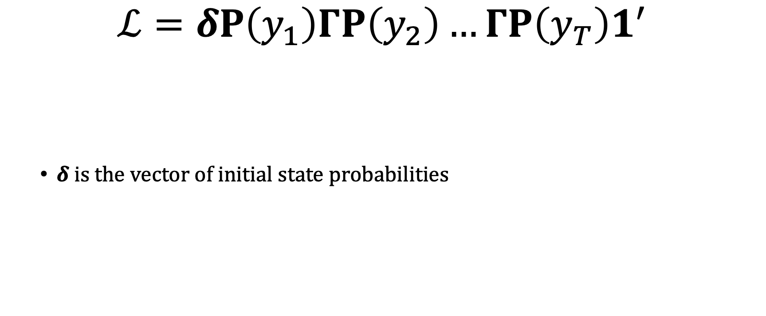
HMM: Likelihood
$$ℒ=δP\left(y_{1}\right)ΓP\left(y_{2}\right)…ΓP\left(y_{T}\right)1^{′}$$
$δ is the vector of initial state probabilities$
Notes:
Finally, we can put everything together to obtain the HMM likelihood. Our first instinct might be to simply take the probabilities of each observation x from t = 0 to the final observation T,
However, this cannot work, because it doesn’t account for the autocorrelation in the latent state. That is the probability of making an observation x at time t is dependent on the observation at t-1 through the autocorrelated hidden state.
The actual likelihood of the Hidden Marko model. We begin with the state distribution at time t=1. this is equivalent to U_{t=1}, which we defined earlier as the vector of state probabilities, next, we multiply this by the emission probability matrix given the first observation to calculate the cumulative probability of the first observation, then we multiply by transition probability matrix gamma, to calculate the state probability in the following step.
Next, we multiply again by the emission probability matrix given observation 2, then again by gamma, and P recursively until the last observation.
We again conclude by multiplying by a column vector of 1s to obtain one value that represents the overall HMM likelihood.
Given all the repetition in this likelihood, it can be written more sucintly as follows. The likelihood is equal to the initial state distribution times emission probability for observation 1, then multiply this recursively by the state transition matrix and emission probability for each observation from time t=2 to the final time step, and conclude again by multiplying by a column vector of 1s.

Slide 14
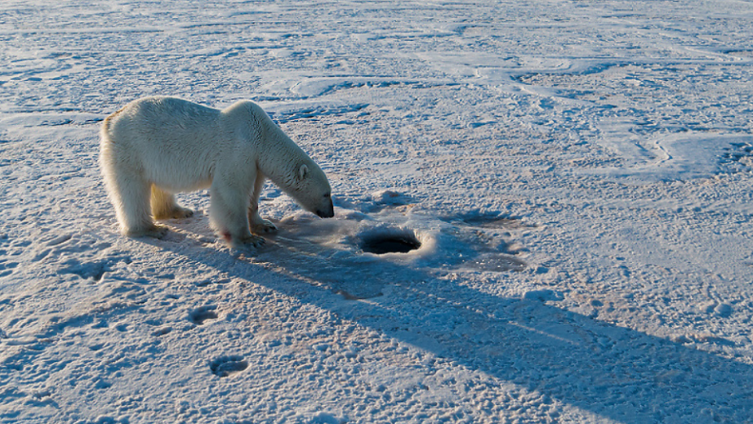
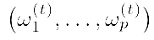
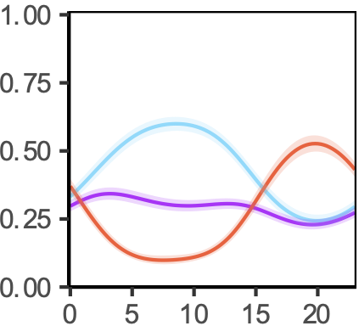
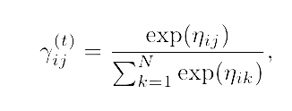
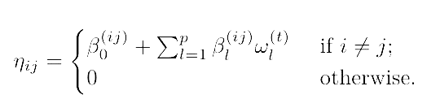
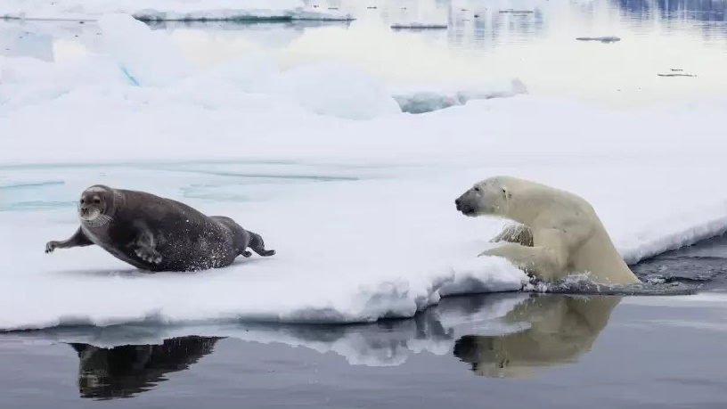
Covariates – hidden process
have an effect on the probability that the animal is in a certain behaviour
Covariates :
©Jami Tarris
State Probability
Hour
Togunov et al. 2022
© Theo Allofs
Notes:
The main pattern observed was that during the early hours of the day, PBs were likely to be in the stationary behaviours, and as the day progressed they were more likely to exhibit active OS.

Slide 15
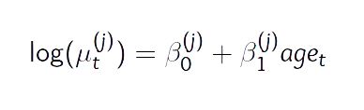
Covariates – observation process
have an effect on the movement
Example: different speed per category of age:

Slide 16
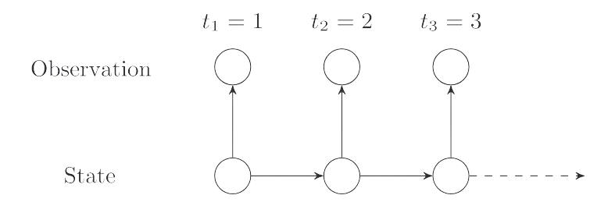
HMMs – Assumptions
HMMs assume regular time intervals between data row
Auto-correlation in the hidden process suffices to characterize the
autocorrelation of the movement.

Slide 17
Correlated Random Walks (Crws)

Slide 18
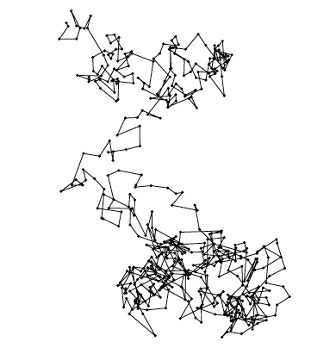
Persistence in direction: CRWs
Simple random walk
Multi-state correlated random walk
Correlated random walk
Michelot et al. 2018
Notes:
The movement model at the core of HMM for animal movement is the correlated random walk. It is one of the most common building block of HMMs.
A correlated random walk is a simple movement model that includes persistence in the movement. On the left, you see a movement path simulated from a simple random walk that does not have correlation in the direction of the movemt, and you can see it is all over the place, and there is no really clear pattern. On the right, you see a correlated random walk and this is more something like we would have we animal movement data. Animal tend to persist in direction. And so w HMMs, we assume that the animals exhibit different behaviours (foraging, traveling) and that within each behaviour, the animal follows a correlated random walk.

Slide 19
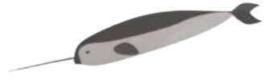
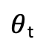
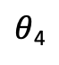
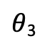
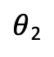
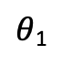
Movement data-streams: step-length and turning angle
Observed step-length
l_{t}
Observed turning-angle
$θ$_{t}
l₀
X₀
$θ$₄
X₄
X₃
l₄
$θ$₁
l₃
$θ$₃
l₁
X₂
l₂
X₁
$θ$₂
Notes:
Hidden Markov models address these challenges by combining two different statistical tools.
For the observation process, we have finite mixture models.
in the graph on the right, the red line represents the overall observation data, and this data is emergent from several hidden processes represented by the blue curves.
To model the autocorrelation, HMMs describe the probability of the latent states using Markov chains, which say that the probability of being in a state at some time depends on what state you were in in the previous time.
In the Markov chain, there is a probability of staying within the same state, and a probability of transitioning to the another states.
Next, we’ll go into both of these components in more detail then discuss how they are combined into the Hidden Markov model.

Slide 20
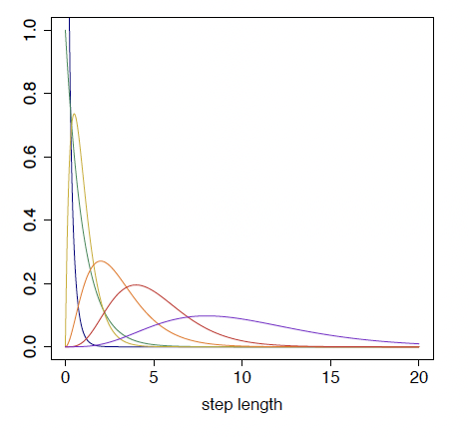
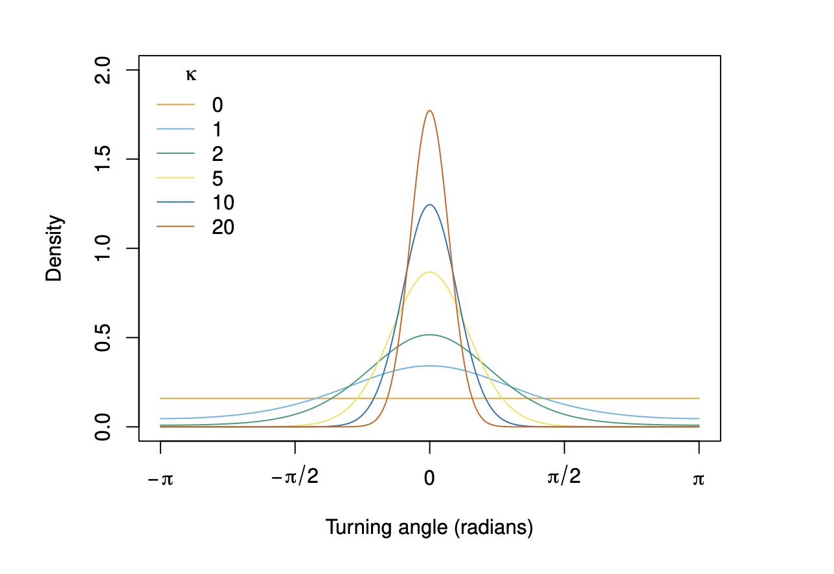
Modelling step-length and turning angle:
gamma distribution
Von Mises distribution

Slide 21
NARWHAL CASE STUDY

Slide 22
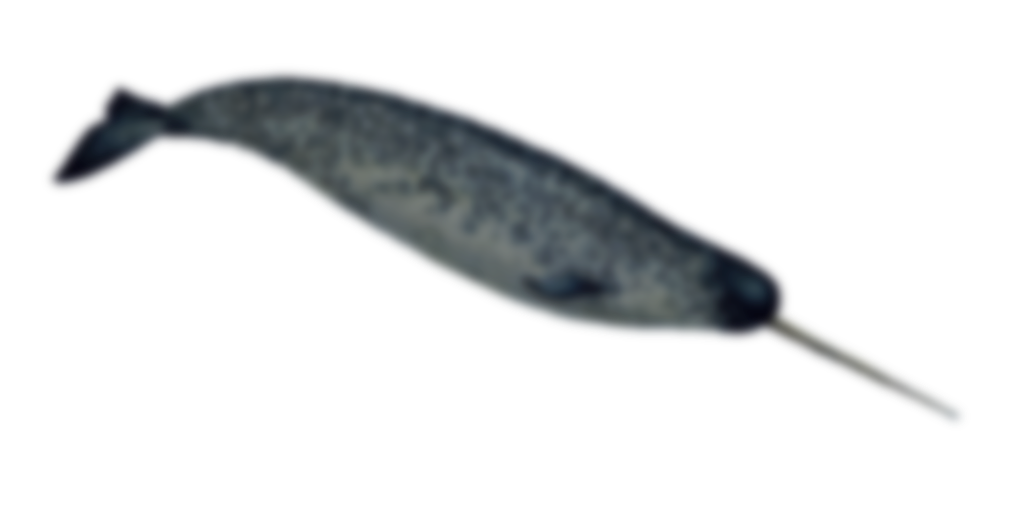
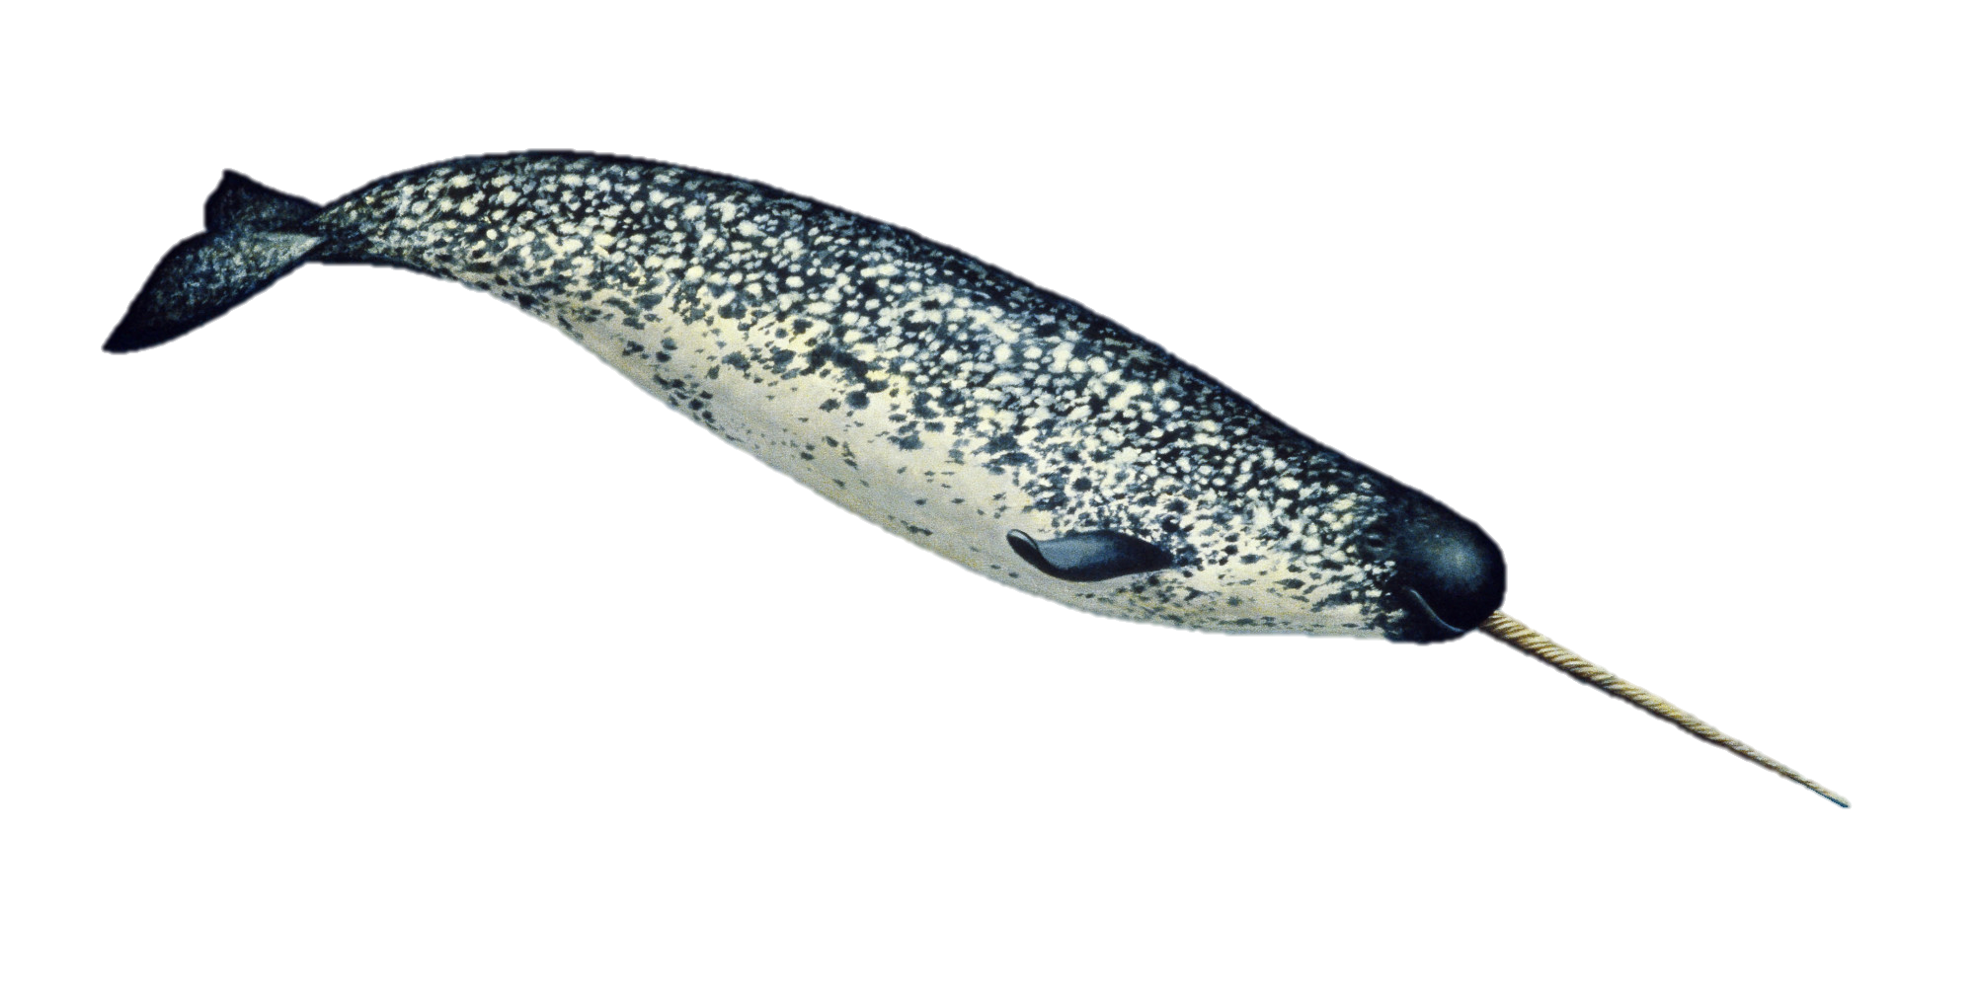
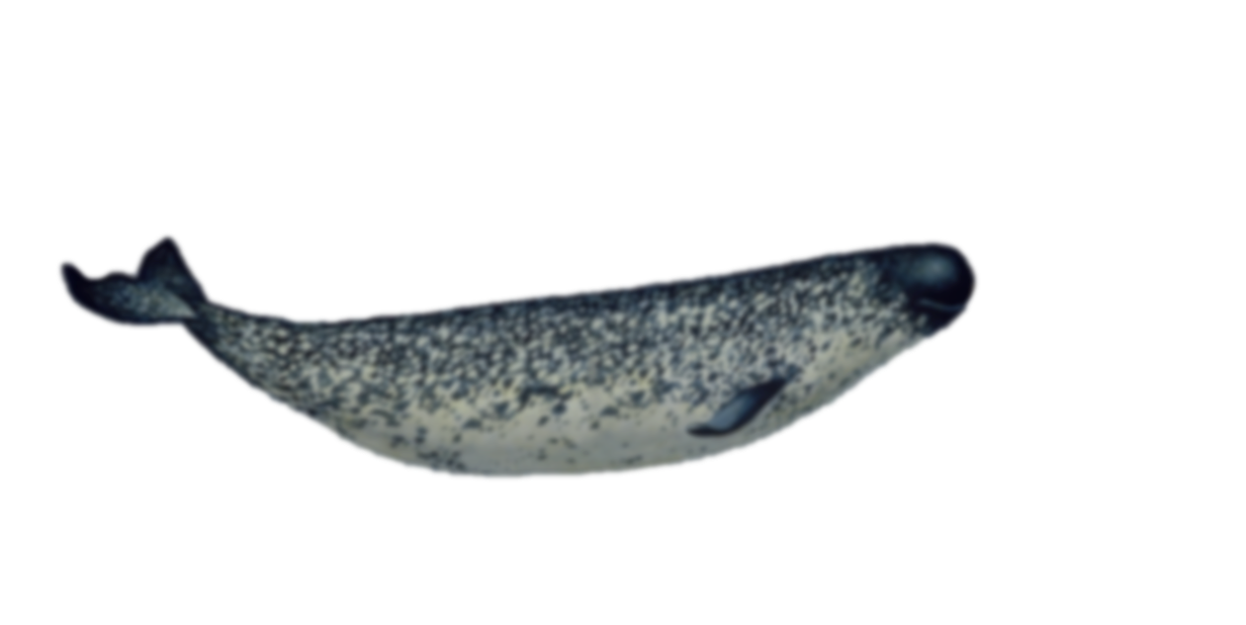
1. Narwhal data
Three Narwhals tagged in Tremblay Sound
Fastloc GPS location data
Raster of bathymetry
Temporal resolution:
Fastloc GPS: 10 min

Slide 23


Polar bear exercise

Slide 24

2. Polar bear data
One polar bear collared in the Beaufort Sea, in April of 2009
One year GPS locations
Temporal resolution:
1 hour

Slide 25

Tutorial’s objectives
Fit simple HMMs using momentuHMM
Checking model fit
Incorporating and interpreting covariates on behaviour transition probabilities
Incorporating covariates in the observation model
(Bonus)
Select an appropriate resolution for the data
Handle missing data

Slide 26
1. Fitting HMM with momentuHMM
Package by Brett McClintock and Théo Michelot, based on moveHMM
Key functions
prepData – prepare tracking data for fitting HMM
Extract environmental data
Calculate step length and turning angle
Calculate circular covariates (e.g., angle relative to ocean currents)
fitHMM – Define HMM structure and fit it to model
Number of states
Distribution associated with each state
Starting parameters
Covariates

Slide 27
prepData(data, type = "LL", coordNames = c("lon", "lat"))
Minimum arguments:
Data (e.g., data = sealreg)
Type - coordinate reference system (“UTM” if not lat/long)
coordNames - names of coordinate columns (if not c(“x”, “y”))
Optional arguments:
covNames – names of covariates (fills in missing data with nearest value)
spatialCovs – raster object from which to extract covariate data
angleCovs – name of angular covariate for which to calculate the relative angle (e.g., turn angle relative to wind

Slide 28

fitHMM(data, …)
Minimum arguments:
nbState – number of behavioural states
Dist – named list distribution associated with each data stream
E.g., gamma for step length and von Mises for turning angle
dist=list(step="gamma", angle="vm")
Par0 – named list initial parameters for data optimisation
E.g., step length l ~ gamma(μ_{i},σ_{i}), define μ and σ for each state
Par0 = list(step=c(mu0, sigma0), angle=kappa0)
Par0 = list(step=c(c(200,500), c(100,250)), angle=c(0.5,0.8))
ϕ
l

Slide 29

fitHMM(data, …)
Optional arguments:
Formula – effects of covariates on transition probability
E.g., formula= ~bathy
estAngleMean – Whether to estimate mean turning angle (default=F)
circularAngleMean – Whether to use a circular-circular distribution for turn angle (use if examining bias relative to multiple factors or if expect non-linear relationship; default = circular-linear)
stateNames – names associated with each behavioural state
retryFits – number of times to attempt to fit the model
DM, workBounds, betaCons, fixPar, …

